Slide 2
RECRUIT THE RECRUITER BRIEFING
Recruit the Recruiter Team
MSG Grambusch, Venessa Recruit the Recruiter Team NCOIC
502-626-1736
SFC Powell, Olisa Recruit the Recruiter Team NCO 502-626-3228
Vacant

Slide 3
RECRUIT THE RECRUITER BRIEFING
Family in Recruiting

Slide 4
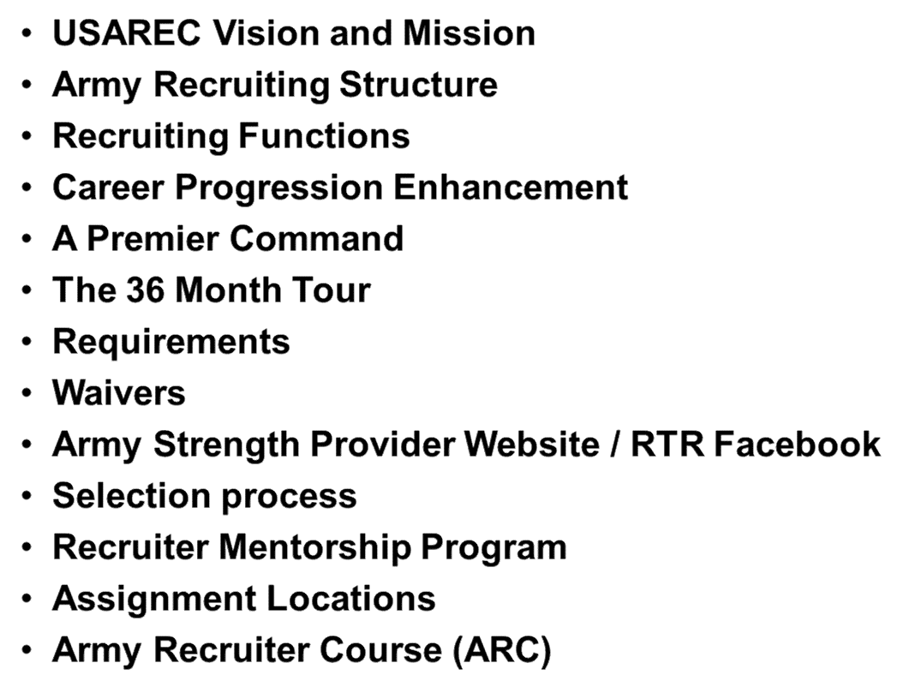
RECRUIT THE RECRUITER BRIEFING
AGENDA

Slide 5
RECRUIT THE RECRUITER BRIEFING
“ An all-volunteer team sustaining an all- volunteer army… A mutually supporting relationship with families & communities enabled by a network of shared knowledge using leading edge technologies & premier recruiting practices.”

Slide 6
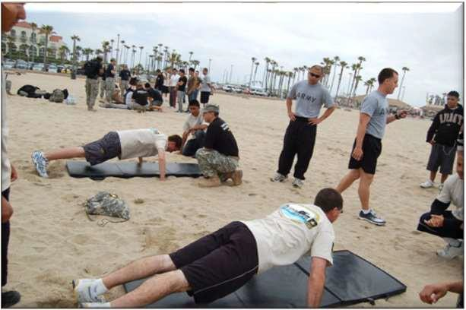
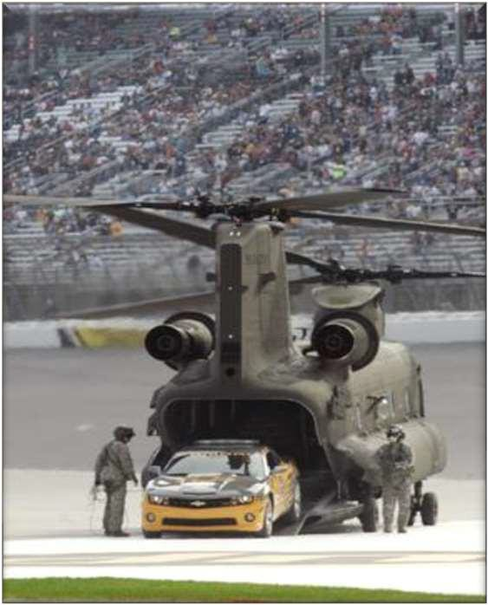
RECRUIT THE RECRUITER BRIEFING
RECRUITING FUNCTIONS
Planning
Operating Environment
Roles and Responsibilities
Recruiting Operations
Decisive Operations
Shaping Operations
Sustaining Operations
Execute Tactical Plan
Community Involvement
Parades
Color Guards
Speaking Engagements
School Presentations
Event Marketing Activities (NASCAR, Air Shows, NHRA, etc.)
Develop Network-Centric Environment
Prospecting
Conduct an Army Interview
Processing
Follow-up Activities
Lead a Future Soldier
School Recruiting Program

Slide 7
RECRUIT THE RECRUITER BRIEFING
-Centralized Promotion Boards look favorably on Special Assignments regardless of CMF/MOS
-Specialized Training which can result in the award of 15 promotion points
and college credit
-Diverse CONUS assignment locations and potential OCONUS assignments
-Unique Leadership Opportunities

Slide 8
RECRUIT THE RECRUITER BRIEFING
A PREMIER COMMAND
Special Duty Assignment Pay (SDAP) $300.00 for the first year and
$375.00 the next year per Month.
Recruiting Expense Account ( REA) $75.00 per Month.
May qualify for Foreign Language Proficiency Pay Language Skill Level $150 monthly depending on availability or eligibility.
36 months stabilized tour after completion of ARC school.

Slide 9
RECRUIT THE RECRUITER BRIEFING
THE 36 MONTH TOUR
The
ARC
(6 ½ weeks)
ADVANCED TRAINING PROGRAM
At 15th months DEVELOPMENTAL COUNSELING by 1SG FOR
POSSIBLE RECLASSIFICATION
TO MOS 79R completed
If NO to 79R CANDIDATE STATUS
If YES to 79R CANDIDATE STATUS
Enrolled in PRE-RESIDENT Station Commander Course (SCC) and scheduled for RESIDENT SCC.
Attend RESIDENT SCC.
DA 4187 - Request to Reclassify will be submitted to Branch.
DA 4187 approved and assignment in a vacant 79R position (as available).
Continue on current tour ending at 36 months
Possibly to still Reclassify while in USAREC command

Slide 10
RECRUIT THE RECRUITER BRIEFING
REQUIREMENT HIGHLIGHTS
Must be able to meet 3 year obligatory service requirements; must be able to reenlist or extend current contract. Creates a Service Remaining Requirement (SRR) if not in within reenlistment window.
No bankruptcy within the past three years, no current credit problems, and adequate spendable income (at least $1000.00 remaining/month).
Dual Military couples or those enrolled in MACP - both must apply and qualify for the program or waive Joint Domicile MACP.
SOLE Parents; can be reviewed with a family care plan and require a waiver.
Meet the Army height/weight standards of AR 600-9 dated (16 July 19)
Minimum PULHES 132321, submit all profiles with MMRB/MAR2 results. No shaving profiles authorized.
Possess a valid civilian driver’s license (waiver not authorized).
No alcohol related incidents within the past 5 years (waiver authorized).
Cannot currently be or have not been enrolled in ASAP within the past 3 years and treatment within 1 year (waiver not authorized).
Cannot be pregnant at time of selection or prior to attending Army Recruiting Course (ARC). Soldier may be considered 6 months after delivery.
At time of selection have no less than 4 years of time in service and no more than 9 years of time in-service if a SGT, no more than 15 years of time in service if a SSG, or no more than 16 years of time in service and 4 years of time in grade if a SFC (waiver by CG, USAREC authorized).

Slide 11
RECRUIT THE RECRUITER BRIEFING
REQUIREMENT HIGHLIGHTS (CONT’D)
Completed one year since reclassification.
At least 18 months Time On Station to apply.
No UCMJ convictions that could result in 2 YRS confinement (felony level).
U.S. Citizen, or legal alien with permanent residence.
Minimum GT/ST score of 90. (waiver authorized)
Meet the age standard: Be at least 21 years old, but not more than 39 years old at time of selection (waiver authorized up to age 45)
Can apply at 24 months on station if in CONUS - If OCONUS, complete 2/3 of a long tour; you must have 6-10 months remaining until DEROS for short tour areas and 6-12 months remaining for long tour areas.
No tattoos that may be perceived as offensive, sexist, distasteful or gang related. Must provide photos of “ALL” tattoos, (except for those in the private areas. These you will provide a drawing in the same format). Meet AR 670-1 dated (26 Jan 21), (Tattoos below the wrist bone and above the t-shirt line that do not violate any other sections of AR 670-1 require an approved tattoo review)
Must have a favorable NACLAC.
“all waivers will be reviewed…if in doubt, submit your packet.”

Slide 12
RECRUIT THE RECRUITER BRIEFING
WAIVERS / SUPPORTING DOCUMENTATION
GT Score Waivers: SRB/STP
Age Waivers: SRB/STP and DA 705 (profile, DA Form 5500/5501 if applicable)
Time In Service (TIS): SRB/STP.
Profile: SRB/STP and Profile (MMRB/MAR2 if applicable)
Financial (this is verification, not a waiver): DA 5425 (must have $1000.00 left each month after all liabilities are paid and 2-3 months worth of BAH in savings preferred)
Sole Parent: SRB/STP and Family Care Plan Statements
Tattoos: All tattoos will be reviewed. Regardless if you are “Grandfathered” to come in or to stay in the army. Clear color photos of all tattoos except for frontal bra and brief area for females and brief area for males.
Law violations (all article 15s and any law violations ie. reckless driving and speeding): Documentation stating charges and all dispositions. If you cannot obtain documentation then provide a letter for your commander detailing the charge(s), date(s), and all final dispositions.
GREEN = can be waived
RED = disqualification
BLUE = documents

Slide 13
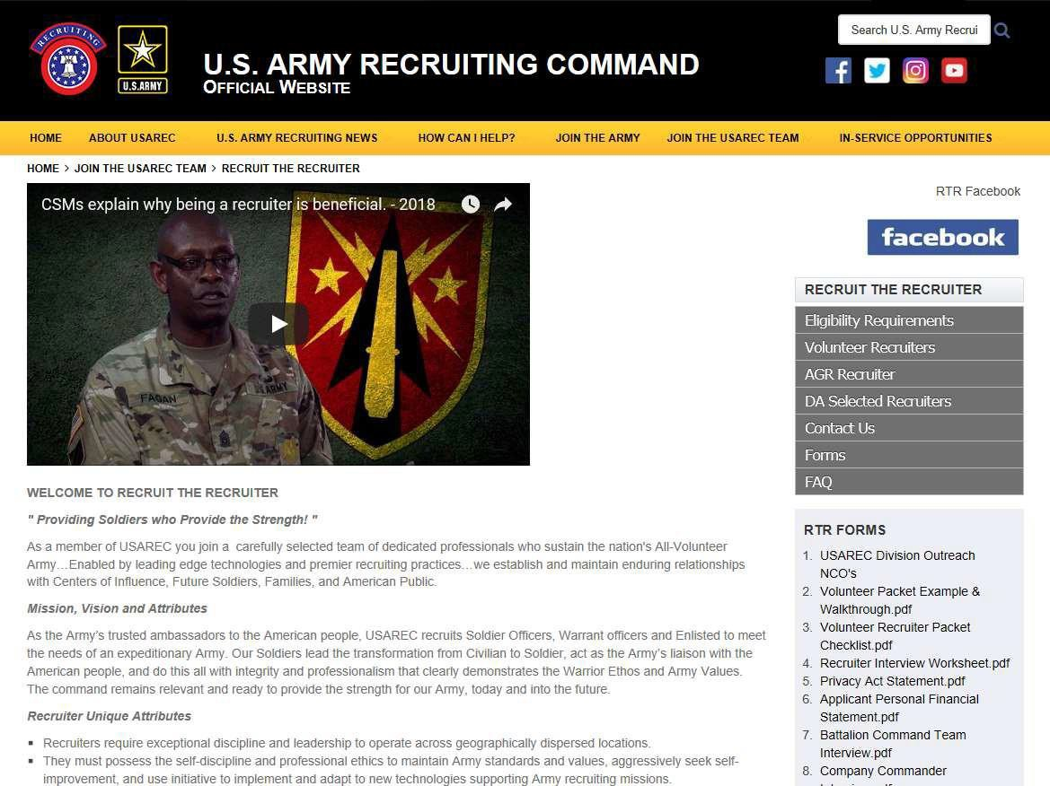
RECRUIT THE RECRUITER BRIEFING
https://usarec.army.afpims.mil/hq/recruiter/ Official site for packets and information

Slide 14
RECRUIT THE RECRUITER BRIEFING
RECRUITER SELECTION PROCESS
Complete and submit your volunteer recruiter packet to the RTR team at USAREC.
Packet Received and processed by the USAREC RTR team.
Name submitted to Branch/Branch Manager for recruiting assignment release. Time is determined by Branch allocations for Special Duty Assignment release.
Once released, HRC schedules tentative ARC report date and initiates
Recruiter Background Investigation.
HRC notifies Soldier of school date.
USAREC G-1 Assignment NCOs will work assignments for OCONUS Soldiers
120-90 days out from their DEROS date.
7. USAREC G-1 Assignment NCOs will contact volunteer recruiters approximately 30-40 days prior to their school start date to address their assignment. **The background check from HRC must be favorably completed prior to addressing your assignment. If the background check is not back then your assignment will not be discussed until it comes back.**
Note: Average process time is 4-6 months from submission to ARC date.

Slide 15
RECRUIT THE RECRUITER BRIEFING
ASSIGNMENTS
Q: WHEN DO I GET MY ASSIGNMENT?
A: VOLUNTEERS and DA SELECTS: Will have their Brigade assignment before arriving to the school and their pinpoint location by the second week of the course. OCONUS: Get an email 120-90 days out and will receive assignment to a recruiting station before attending the ARC.
Q: WHO DO I CONTACT ABOUT ASSIGNMENTS?
A: VOLUNTEERS ONLY USAREC G-1 ASSIGNMENT TEAM via email
usarmy.knox.usarec.mbx.hq-g1-das-recruiter-assignments@army.mil.

Slide 16
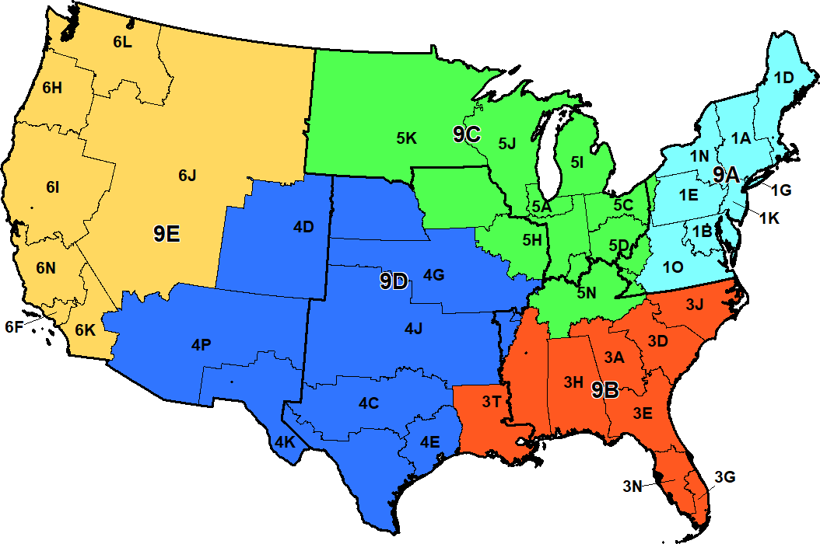
RECRUIT THE RECRUITER BRIEFING
Recruiter Assignment Preference Map
Rank and Best Point of
Name: SSN: - - Contact Phone: ( ) -
Select a total of ten Battalions from the five Brigades listed below. Choose no more than two Battalions per Brigade. Number your selections one (1) through ten (10) with 1 being the most desired. Soldiers who are 68 series only, may select an additional two Battalions in the Medical Recruiting Brigade.
Recruiter preference is not guaranteed but will be considered
1st BDE
2nd BDE
3rd BDE
5th BDE
6th BDE
MR BDE
(CMF 68 only)
1A Albany
1B Baltimore
1D New England
1E Harrisburg
1G New York City
1K Mid-Atlantic
1N Syracuse
1O Richmond
3A Atlanta
3D Columbia
3E Jacksonville
3G Miami
3H Montgomery
3J Raleigh
3N Tampa
3T Baton Rouge
5A Chicago
5C Cleveland
5D Columbus
5H Indianapolis
5I Great Lakes
5J Milwaukee
5K Minneapolis
5N Nashville
4C Dallas
4D Denver
4E Houston
4G Kansas City
4J Oklahoma City
4K San Antonio
4P Phoenix
6F Los Angeles
6H Portland
6I Northern Cal
6J Salt Lake City
6K Southern Cal
6L Seattle
6N Cent Cal
9A 1st MR BN
9B 2nd MR BN
9C 3rd MR BN
9D 5th MR BN
9E 6th MR BN

Slide 17
RECRUIT THE RECRUITER BRIEFING
ARMY RECRUITER COURSE
The ARC relocated to Ft. Knox in January 2015.
The Course is 7 Weeks and 3 Days long.
9 Major Segments
Enlistment Eligibility
Recruiting technology
Recruiting knowledge
Interpersonal and Communication Skills
Prospecting
Interviewing
Processing
Recruiting Exercise (RECEX)

Slide 18
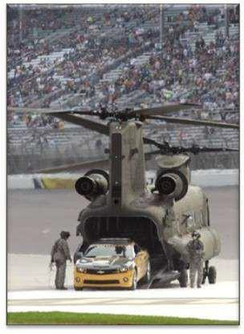
RECRUIT THE RECRUITER BRIEFING
USAREC NEEDS MOTIVATED NCOs!
Tell YOUR Army story to future Soldiers
Provide leadership and mentorship
Be a role model within your community
Help someone find their strength
What’s in it for you?
36 months dwell time
Subsidized child care
Opportunity for Career Advancement

Slide 19
RECRUIT THE RECRUITER BRIEFING
usarmy.knox.usarec.mbx.HQ-g1-rtr@army.mil
or
DSN: 536-xxxx Comm:
502-626-1736/3228
MSG Venessa Grambusch/SFC Olisa Powell
or
Division Outreach NCO at the nearest Military Installation

Slide 20
RECRUIT THE RECRUITER BRIEFING

